Slide 1
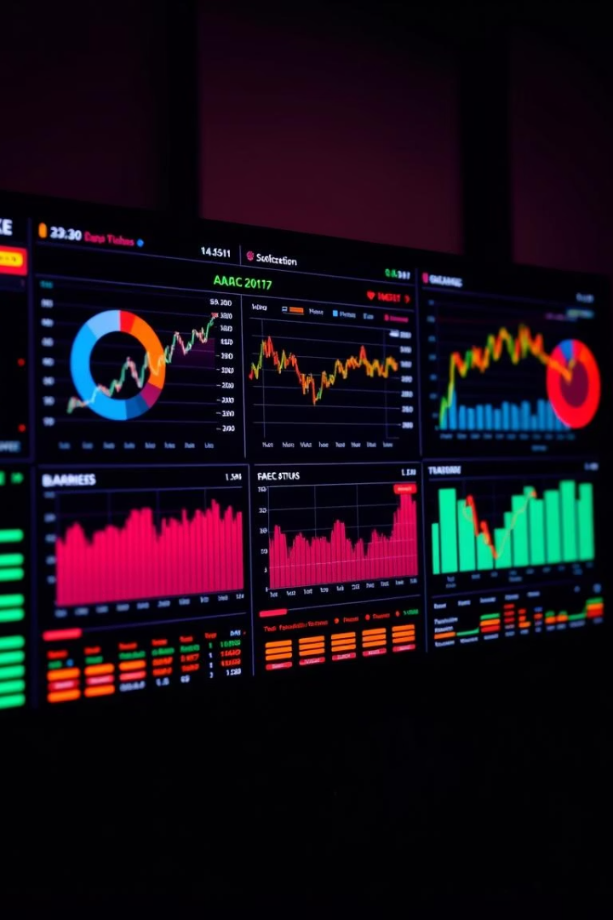
Stock Market Analysis: A Data Analyst's Perspective
This presentation explores how data analysts transform stock market insights. We will show how raw data is refined into actionable intelligence. We will cover key analytical techniques and visualization methods. You will discover data-driven strategies for investment decisions.
Group 2
Andrajula Guru Saipavan.
Jinal Praful Sangani
Mobin Ahmed Khan
Sarvesh Uday Ghadi
Kasireddy Krupakar Reddy
Sahil Rajan Malkar

Slide 2




The Role of a Data Analyst in the Stock Market
Transforming Raw Data
Identifying Trends
Spotting patterns and anomalies.
Converting data into actionable insights.
Predictive Modeling
Forecasting market behavior.
Data analysts play a crucial role. They transform raw data into strategic insights. They forecast market trends and reduce risks. This data-driven approach maximizes investment returns.

Slide 3

Project Overview
Objectives
Tools Used
Analyze major tech stocks using historical data.
Power BI for data visualization.
Identify key market indicators.
Tableau for interactive dashboards.
Assess price trends and volatility.
Excel for data analysis.
SQL.
Apply technical analysis tools.

Slide 4
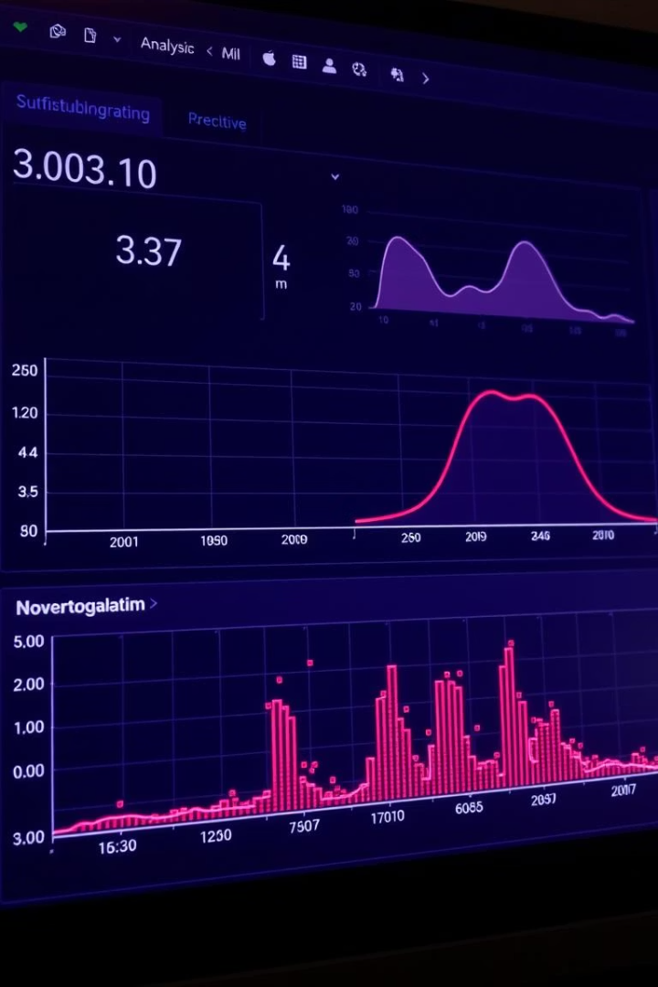



Essential Analytical Techniques: Descriptive Statistics
Central Tendency
Mean, median, mode.
Measures of Dispersion
Standard deviation, variance.
Outlier Detection
Identify anomalies.
Descriptive statistics are essential for initial data understanding. Central tendency reveals typical values. Dispersion measures data variability. Outlier detection highlights unusual data points.

Slide 5

Key Performance Indicators
$276B
$75M
Total Volume
Average Gain
Reflects overall market activity.
Highlights profitable trades.
-$4.6M
Average Loss
Indicates risk exposure.

Slide 6





Price Trends and Closing Analysis
Upward Trend
Overall stock prices increased.
Recent Dip
Experienced a decline in 2023.
Fluctuations
Monthly closing prices varied.

Slide 7



Profit/Loss & Returns
AAPL
1
54.13%
AMZN
2
24.66%
FB
3
21.2%
Daily returns distribution varied by stock. AAPL showed the strongest returns. February saw the biggest loss at -15B.

Slide 8




Data Visualization for Clear Insights
Impactful Charts
Interactive Dashboards
Real-Time Monitoring
Effective visualization is key to communicating findings. Charts and graphs simplify complex data. Interactive dashboards allow real-time monitoring.

Slide 9

Technical Indicators Analysis
MACD Trends
Bollinger Bands
Identified key trend reversals.
Measured price volatility effectively.
RSI & SMA
Provided insights into market momentum.
Conditions: Overbought/Oversold.
RSI and SMA values provided early warnings of market dips.

Slide 10



52-Week High/Low & Beta
High: $553,004
Low: $281,130
Beta Analysis
Peak stock valuation.
Lowest recorded value.
AAPL showed highest consistency.

Slide 11
Key Data Insights
Stable Growth
Volume Trends
Profit Patterns
Overall upward trend in stock prices from 2010 to 2023 despite minor corrections.
MSFT had the highest trading volume, indicating strong market interest.
October recorded the highest profit (+12B), while February saw the largest loss (-15B).
High Performers
Technical Indicators
AAPL and GOOGL showed consistent gains and lower volatility.
RSI and SMA values provided early warnings of market dips and corrections.

Slide 12
Challenges in Stock Market Analysis
Selecting the Right Metrics: Defining KPIs that truly reflect business goals can be tricky.
Overfitting or Under fitting Models: In predictive analytics, the model may not generalize well.
Indicator Conflicts: RSI and MACD sometimes produce conflicting signals, complicating decision-making.
Missing or Incomplete Data: Key values may be blank, requiring imputation or careful exclusion.
Data Integration: Combining insights from Tableau, Power BI, and Excel can be time-consuming and prone to inconsistencies.
Slow Performance: Dashboards or scripts may run slowly on large datasets.

Slide 13
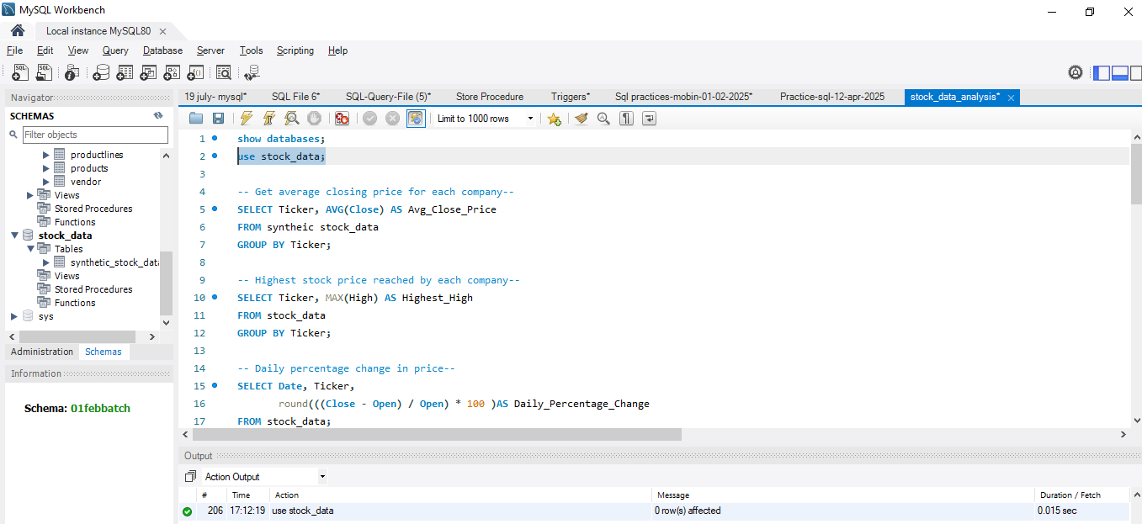
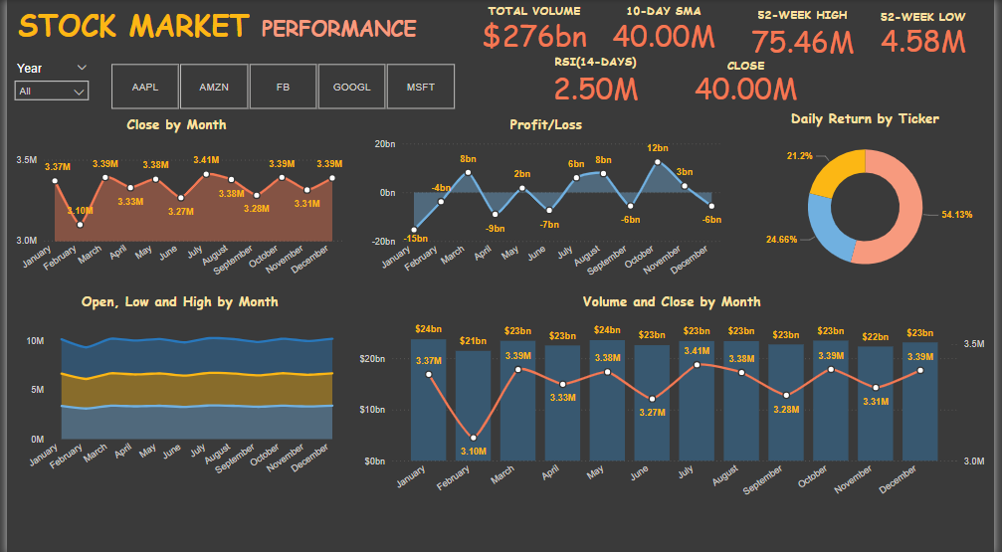
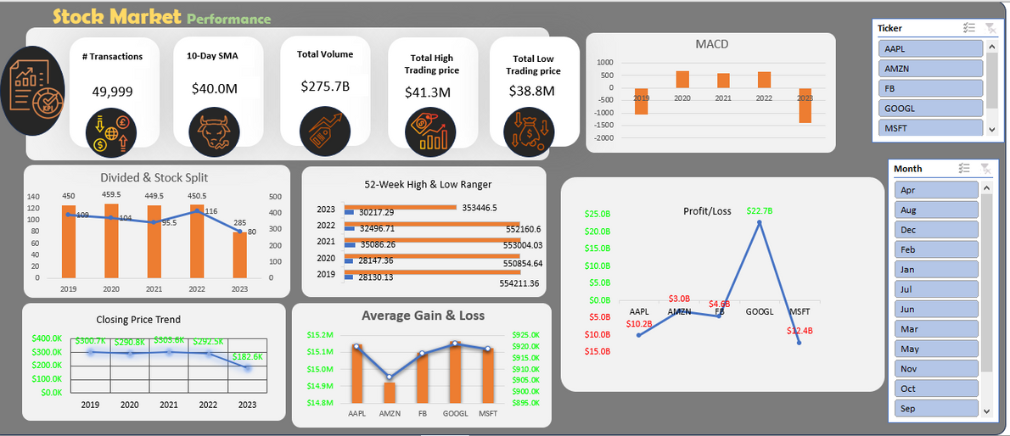
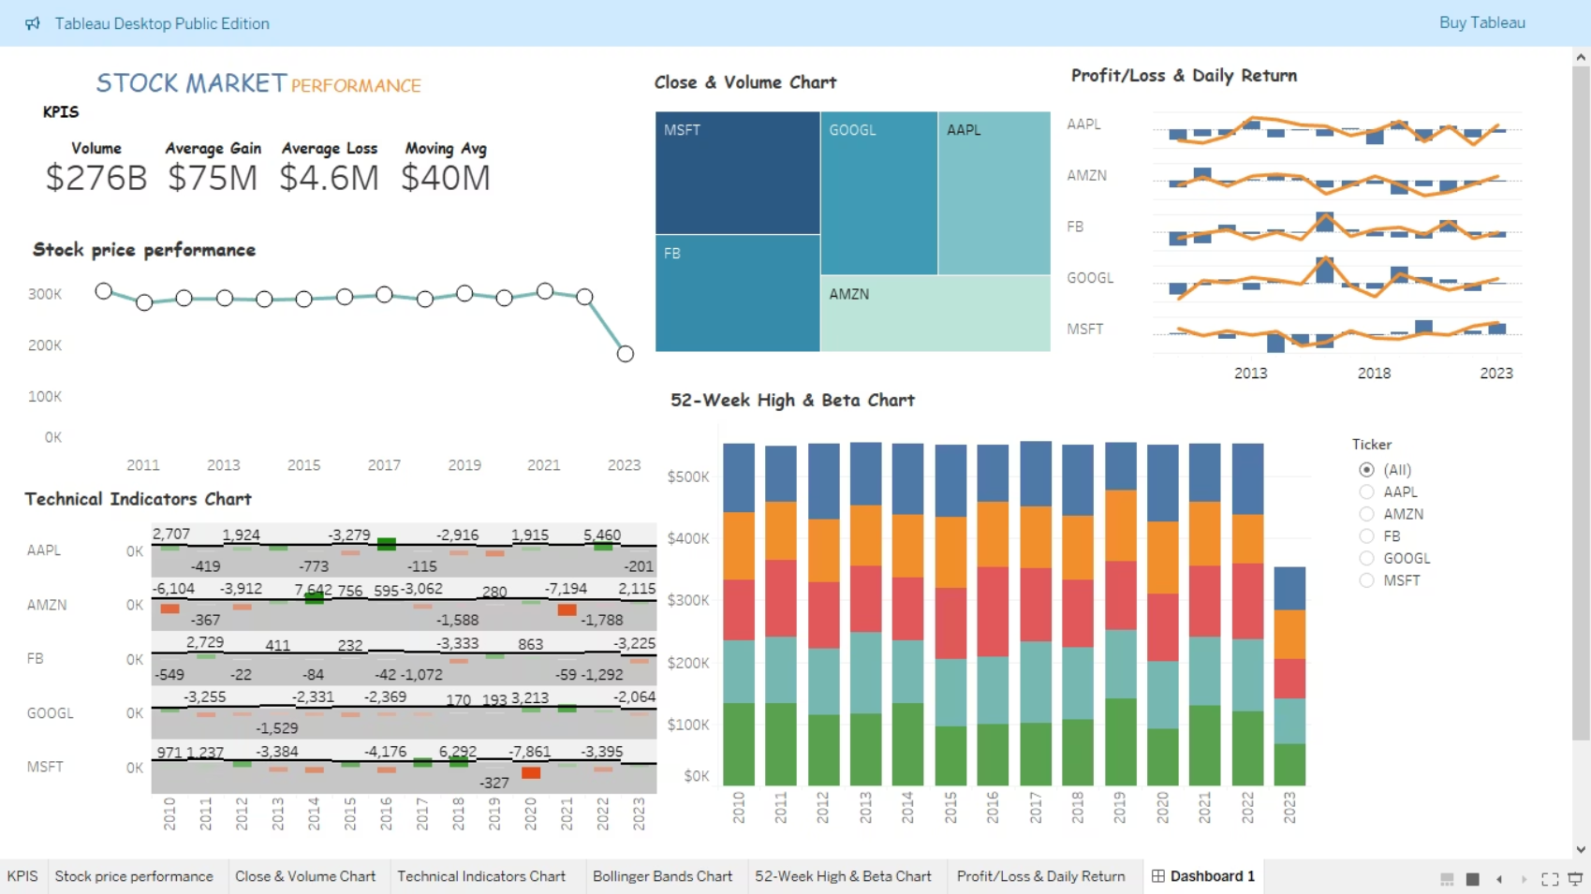
Dashboard View - Power BI, Tableau, Excel & SQL

Slide 14

Key Takeaways and Gratitude
Analytical Skills
Actionable Feedback
Hone data analysis skills
Address areas for improvement
Apply models effectively
Drive practical implementation
Thank you for active participation, valuable insights, and collaborative spirit.

